Slide 1



Mask Capital
Ellipsis Tech Series Hackathon 2020
7 September 2020
School : Singapore Management University
Team Members: Christel Seah, Genice Goh, Lim Zhi Hao, Josiah Wong,
Notes:
Good afternoon judges, we are Mask Capital, comprising of Christel, Genice, Zhi Hao and Josiah.

Slide 2
Proposed Solution
Problem Statement: As financial information is becoming increasingly accessible and more diverse in nature, it is important that youths have the access to the right information to help facilitate an apt investment plan for retirement.
Youths that engage in investing
Reasons for not investing
Our Solution: A one stop platform that provides you with financial information at your fingertips – with a purpose of educating you on how to have your assets work for you
Proposed Solution
Business Case
Solution Architecture
Frameworks
Demonstration
1
Notes:
Financial information is becoming increasingly accessible and are becoming more diverse in nature. It is therefore important that youths have access to the right information to help facilitate an apt investment plan for retirement. These statistics are pretty worrying in the sense that only a third of youths surveyed have started investing and 61% actually cited having no idea how to start investing as one of the key reasons for not investing.
Therefore, Mask Capital proposes our solution – a one stop platform that provides one with financial information – at one’s fingertips to educate youths on making their assets work for them.

Slide 3
Business Case
The needs analysis of the youths and the core features of our application
Features
Considerations
1
Educational Platform
With a multitude of information out there, there is often a lot of ”noise” in the market. Our one stop platform equips one with the relevant financial knowledge
Risk Appetite
Right Info
Demographic
Youths have a higher risk appetite
Asset classes like stocks would be ideal in assumption of the higher risk appetite of youths
With a myriad of information in the market, it may be hard to find the relevant information
Our one stop information portal saves time and facilitates learning
Youths value aesthetics and an interactive user interface
An incentive for them to keep coming back to use our platform
2
Dynamic Information
Leveraging on the real time dynamic information obtained through API’s, it allows the user to see the changes in the market and be better equipped to make sound investment decisions
Interactive Pedagogy
Our application uses an interactive interface to appeal more to the users which are youths, making the learning experience more enriching
3
By understanding the pain points and needs of our target audience, the features incorporated would focus on meeting these needs
User Centricity
Proposed Solution
Business Case
Solution Architecture
Frameworks
Demonstration
2
Notes:
The key features of our web app is to serve as an education platform with dynamic information and interactive pedagogy. Our considerations are that of the risk appetite of the younger generation, providing right information and the demographic of the younger generation.
By understanding the pain points and needs of our target audience, the features incorporated would focus on meeting these needs.

Slide 4







Solution Architecture
Business
Financial Literacy
Financial Markets
Target Audience: Youths
Application
Our web application – a one stop educational platform to start your investment journey
APIs used to retrieve real time trading information from Alpha Vantage which provides stock and FOREX APIs
Technology
React JS was used to host the application running the API calls
Web Application supported by Vanilla, CSS and HTML frameworks
Proposed Solution
Business Case
Solution Architecture
Frameworks
Demonstration
3
Notes:
This is our solution architecture. When we first look at the business aspect, the issue here is to give youths a platform to start investing. On the application level, our web app serves to provide a one stop education platform for youths to start their investment journey. We also used APIs to retrieve real time market information from Alpha Vantage which provides stock and FOREX APIs. Under pinning the technology layer, we used React JS to host the application running the API calls and also vanilla, CSS and HTML frameworks to support our web app.

Slide 5
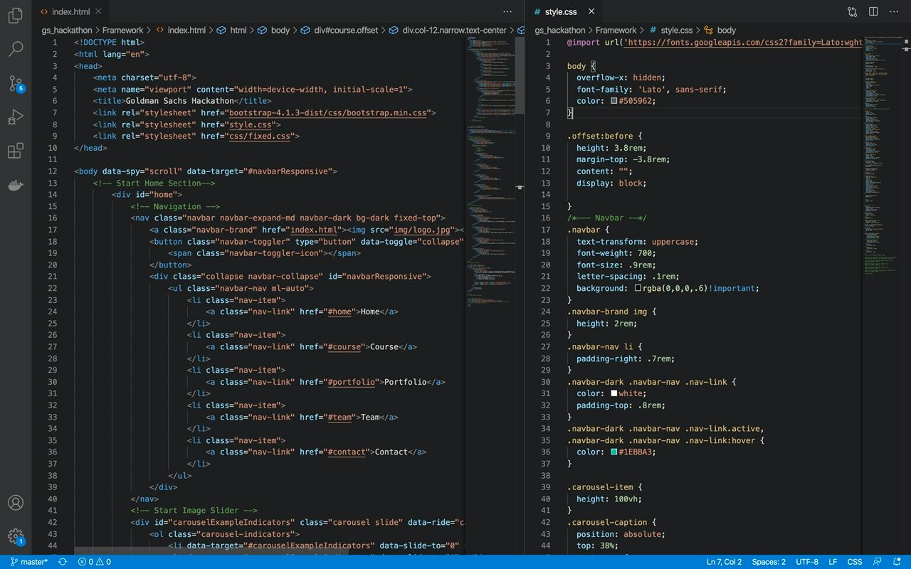
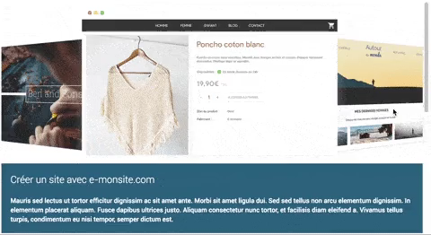
Frameworks
API
Custom bootstrap framework with Vanilla, CSS and HTML
Parallax Scrolling
Proposed Solution
Business Case
Solution Architecture
Frameworks
Demonstration
4
Notes:
Our frameworks include custom bootstrap framework with vanilla, CSS and html and we used parallax scrolling as part of the interface. Moreover, we utilised the Time Series Stock API from Alpha Vantage to show the most recent 1-2 months of intraday time series of the equity specified. We hope to use this to educate the financially illiterate to read the prices and determine whether it's a good time for them to invest.

Slide 6
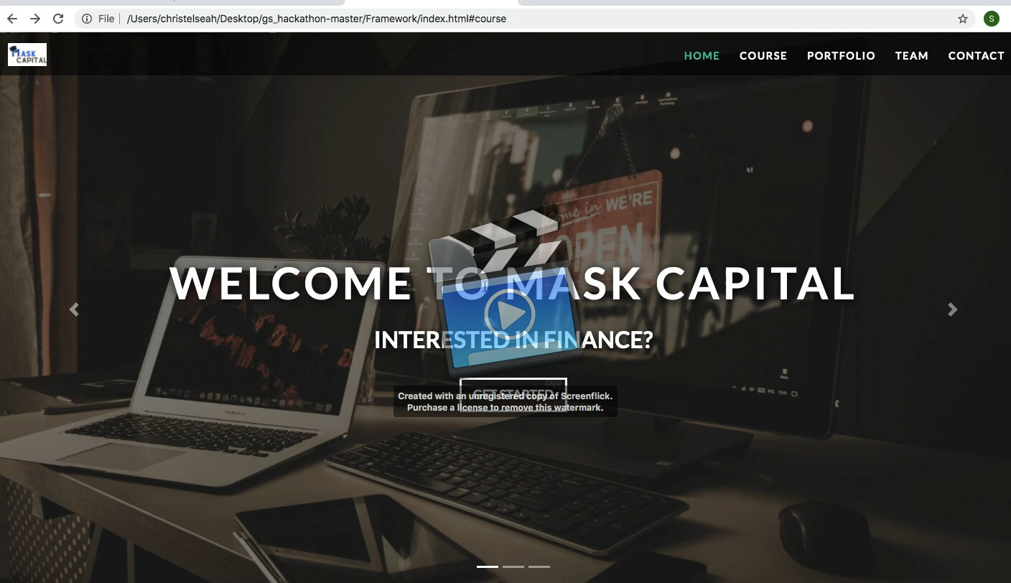
Demonstration
Proposed Solution
Business Case
Solution Architecture
Frameworks
Demonstration
5
Notes:
We will now show the demonstration of our web app.

Slide 7
End of Main Deck
Ellipsis Tech Series Hackathon 2020
7 September 2020
School : Singapore Management University
Team Members: Christel Seah, Genice Goh, Lim Zhi Hao, Josiah Wong
Notes:
With that, we have come to the end of our presentation. Thank you.

